Slide 1
Arts and Culture Roundtable
19 September 2018 Melbourne Recital Centre

Slide 2
Committee for Melbourne Welcome
David Prior

Slide 3
Host welcome: Melbourne Recital Centre
Sandra Robertson

Slide 4
Guest Speaker
Jesse Cain, Marriner Group

Slide 5
https://www.dropbox.com/s/6ql44m41ynwfh36/CFA_TVC.mp4?dl=0
Come From Away Australia

Slide 6
Enabling Creativity in Melbourne working group update
Facilitated discussion lead by David Prior

Slide 7
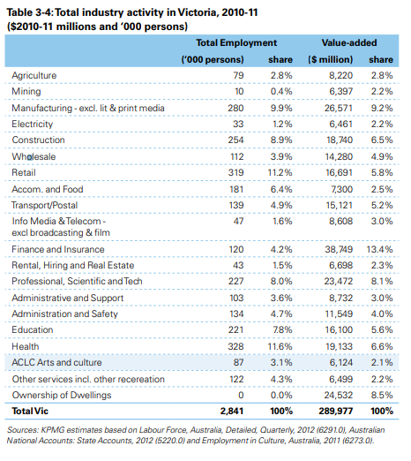
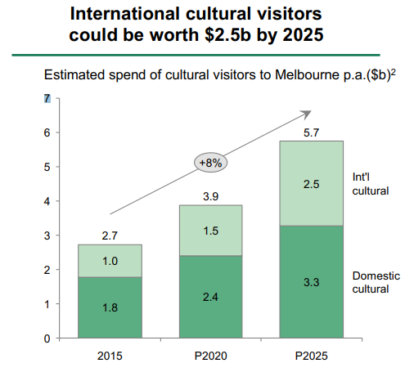
Background – research shows economic impact of Arts
Melbourne as a global culture capital, BCG report commissioned by Creative Victoria, 2017
Economic impact of Arts in Victoria, KPMG report commissioned by Creative Victoria, 2013

Slide 8
Background – Issues for Artists are documented
Making Arts work, Australia Council report, 2017
It is difficult for artists to make a living
Artists general embrace the use of technology to collaborate, promote and sell.
- Increased online presence makes living as an artist difficult
Support from government, business and philanthropy is important to keep arts going
Melbourne as a global culture capital, BCG report commissioned by Creative Victoria, 2017
Key recommendation (one of several)
Protecting existing infrastructure: expanding supply of creative working spaces, addressing critical maintenance backlog

Slide 9
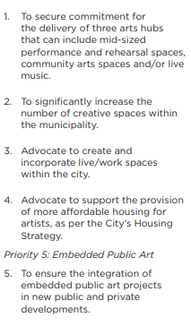
Background – Councils are looking at the issues
Arts Infrastructure Framework, City of Melbourne, 2016
Housing the Arts, City of Melbourne report, 2007
Recognises there is a problem with affordable space
Set up a system for giving grants to developers who encouraged artistic spaces

Slide 10
Conclusions
Melbourne’s economy benefits from the Arts and Creativity
Grassroots creatives are facing issues which will negatively effect Melbourne’s scene
Enabling creativity working group

Slide 11
Review of spaces in Melbourne
1460 spaces listed in total
Tenure of available spaces
 | hour | half-day | day | week | month | year
Mean | $ 54.50 | $ 276.39 | $ 367.96 | $ 495.01 | $ 1,060.64 | $ 42,952.20
Median | $ 38.50 | $ 200.00 | $ 287.00 | $ 165.00 | $ 547.80 | $ 11,299.36
SD | $ 59.98 | $ 243.81 | $ 375.59 | $ 1,242.90 | $ 2,085.43 | $ 91,934.53
22 free spaces listed
Average cost of spaces
Data scraped from creativespaces.net.au with owner’s permission

Slide 12
Review of spaces in Melbourne

Slide 13
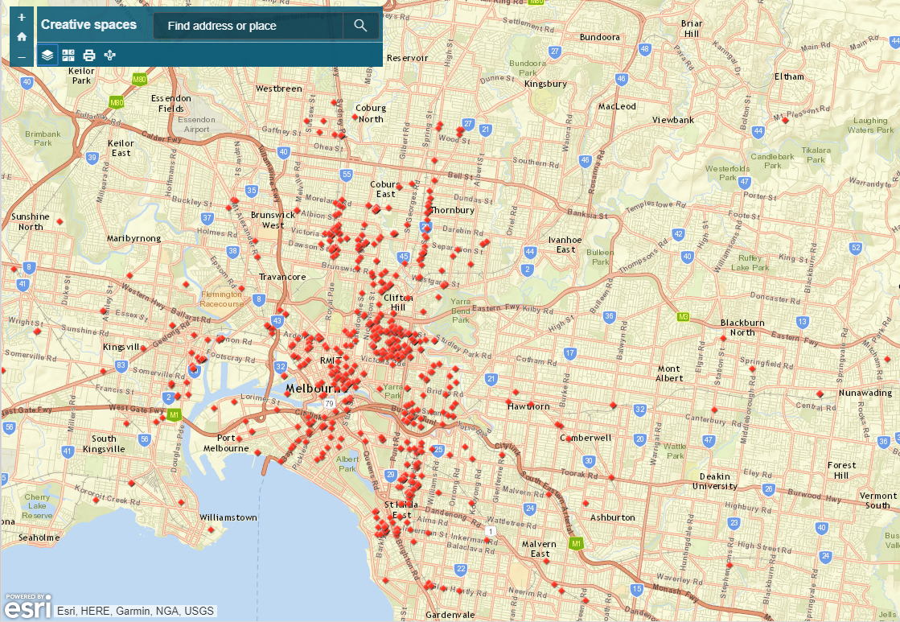
Review of spaces in Melbourne
https://arcg.is/1yLiqO

Slide 14
3 needs identified
Stronger creative community
More studio space
More exhibition space
More international engagement

Slide 15
Responses to 3 needs identified
More studio space
More exhibition space
More international engagement
Unlock existing spaces, universities, schools, unused areas
Look at planning stage of developments to “get in early”
Possible 3 year trial
Look at inventive ways for creatives to exhibit
Approach businesses to allow artists to display their art
Consider upcoming development areas
Consider out studio space can be accessible to public
Look at programs currently happening and how they can be expanded
Consider partnerships with organisations who are interested in promoting Arts
For example, Asia Society has a large art branch

Slide 16
Discussion

Slide 17
Winter reactivation event
Clive Scott, Sofitel Melbourne
Michelle King, Australia Accommodation Association of Australia

Slide 18
Closing business
David Prior

Slide 19
Upcoming events
October 22nd : The Adventures of Rock Art (TARA) event with The Kimberley Foundation
December 11^{th:} Arts and Culture roundtable
Ongoing activities
Free Tram Zone extension submission
Enabling creativity in Melbourne Working Group

